Slide 1
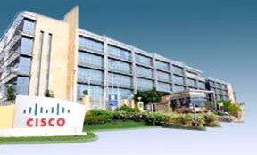
SOA & Web Services
Advanced Java Training
S Vastrad
June 21st 2011

Slide 2
Agenda
SOA Overview
Web Service Overview
SOAP and REST
SDF 3.0
Exercise

Slide 3
Perquisites
LDE 3.0 (http://dft.cisco.com/wps/myportal/dft/download/lde30 ) or eclipse (http://www.eclipse.org/downloads/ )
A Web server preferable Tomcat (LDE 3.0 has inbuilt tomcat server) (http://tomcat.apache.org/download-70.cgi )
SDF 3.0 Library (http://ework.cisco.com/Livelink/livelink.exe?func=ll&objId=44894878&objAction=Open )
Rest Client Add on for Firefox (https://addons.mozilla.org/en-US/firefox/addon/restclient/)
SOAP UI : http://sourceforge.net/projects/soapui/files/soapui/3.6.1/soapUI-x32-3_6_1.exe/download

Slide 4
What’s Not SOA?
SOA doesn’t necessarily mean Web Services .
SOA is not just Technology Architecture or an out-of-box technology
SOA is not one time approach , implement and done
SOA is not just applications integration
Notes:
Web Services can be part of SOA strategy but not required
Technology architecture helps enable SOA . There is no one standard technology to implement SOA .
SOA is not one time deal , it’s an evolution strategy
It’s not just bunch of application integration within an organization

Slide 5
What’s SOA?
SOA is foundation for strategic business transformation . Its about modeling business processes.
SOA is set of design principles. Its way of architecting & organizing IT infrastructure and business functionality
SOA is an evolutionary approach
SOA involves effective governance framework, standards and processes.
Notes:
SOA concept is to design software around business capabilities needed within organization .
- SOA is a paradigm for designing, developing, deploying and managing services – Service should have well defined interfaces and encapsulate key business processes
It’s step by step approach starting with identifying business processes , leverage existing IT applications and infra assets, building net new services. This approach makes business agile and rapidly respond to the business needs
It’s not just bunch of application integration within an organization . There needs to be effective governance model , best practices and standards , development guideleines

Slide 6
Service In Different Contexts ..
Services
The means of delivering value to Customers …without the ownership of specific costs and risks. ITIL V3
Example : Tax Paying Service
IT Services
Services
IT Services
Identifiable technology-related solutions with well-defined functional and operational characteristics.
Example : Sales IT , Marketing IT
WebServices
Web Service
Modular application components with well-defined interfaces that can be invoked over the Internet.
Example : Pricing service
Notes:
Service: “A means of delivering value to Customers by facilitating outcomes Customers want to achieve without the ownership of specific Costs and Risks. “ ITILV3
where we are today with SOA, and how it contributes to moving IT to a services model.
ITILV3 definition
Getting a service - benefit from the outcome w/o the risk and cost associated
IT Service: An identifiable technology-related solution with well-defined functional and operational characteristics. An IT Service either directly enables Business Capabilities or indirectly enables them by providing necessary foundational functionality. IT OM Taxonomy
IT service: (Cisco definition)
Technology related
Functional and operational characteristics
Directly or indirectly enable business capabilities
SOA Service: A modular application component that can be invoked over the Internet. The consumers are other applications, services and business processes that communicate with the SOA Service, typically using XML standards.
An application component that can be invoked over the Internet.
SOA service consumers: are other applications, otherservices and business processes
Standards: typically using XML standards including SOAP, WSDL, and UDDI.
Modular – a building block, can be reused,
SOA services group is a subset of IT services
(have similar characteristics and unique ones)
In following slides will discuss more specifically

Slide 7
Web Service Definition
"A Web service is a software application identified by a URI, whose interfaces and bindings are capable of being defined, described and discovered as XML artefacts. A Web service supports direct interactions with other software agents using XML based messages exchanged via internet-based protocols."
http://www.w3c.org/TR/2002/WD-wsa-reqs-20020819

Slide 8
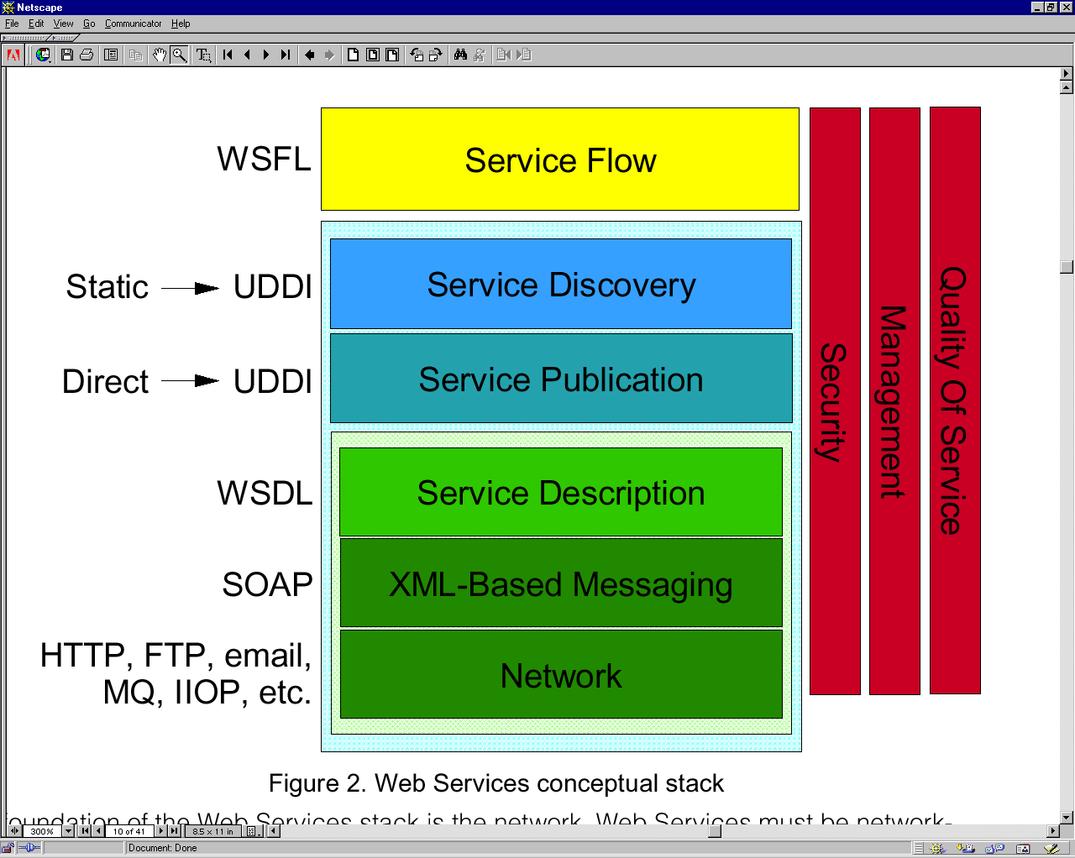
Web Services Stack

Slide 9
SOAP Implementation Overview
Controller
Model
Human Web
Programmable Web
View
View
View
Portal
CCX App
Partner
Cisco Device
Scripted Interface
One unique addressable interface.
Varied set of methods
Varied set of methods
Varied set of methods
WebService
System of Record DB

Slide 10
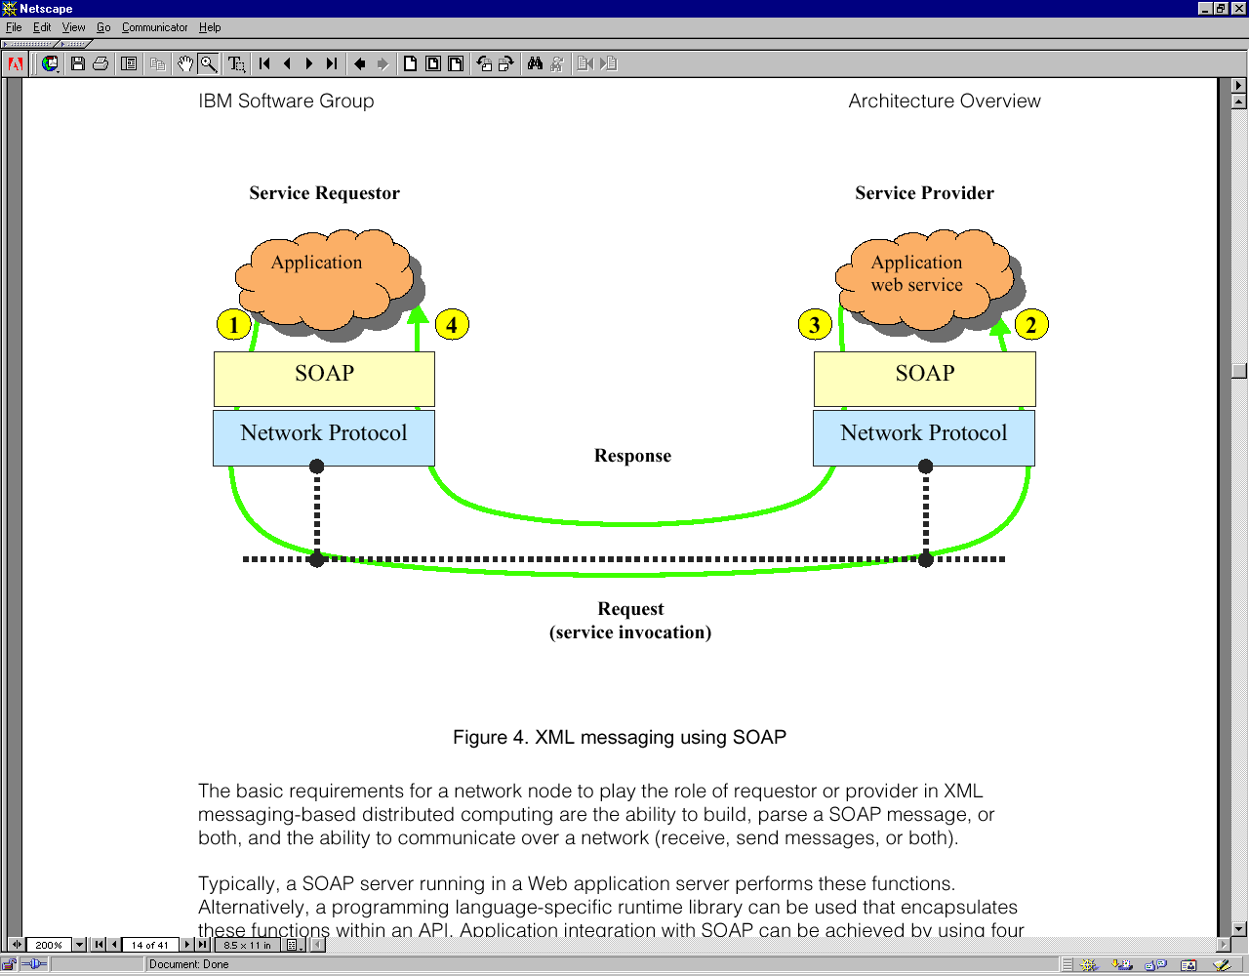
XML Messaging Using SOAP

Slide 11
SOAP – Simple Object Access Protocol
SOAP is XML-based message protocol for exchanging information between computers.
SOAP message has
Envelope: ( Mandatory ) Defines the start and the end of the message.
Header: ( Optional ) Contains any optional attributes of the message used in processing the message, either at an intermediary point or at the ultimate end point.
Body: ( Mandatory ) Contains the XML data comprising the message being sent.
Fault: ( Optional ) An optional Fault element that provides information about errors that occurred while processing the message
SOAP is not tied to any one transport protocol.
SOAP/HTTP SOAP/JMS
More Information
SOAP Version 1.1 is available online at http://www.w3.org/TR/SOAP/
The working draft of SOAP Version 1.2 is available at http://www.w3.org/TR/soap12/

Slide 12
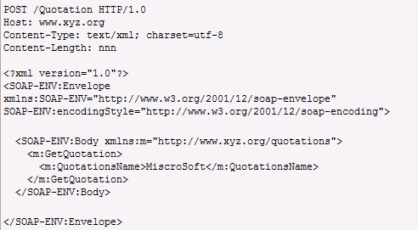
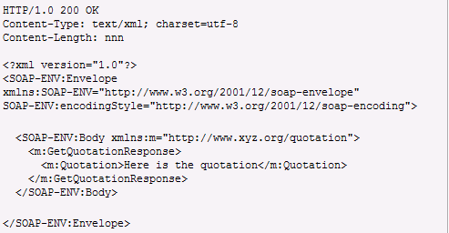
The SOAP/HTTP Message – On Wire

Slide 13
WSDL – Web Service Description Language
WSDL is an XML-based interface definition language that provides operational information about a service, such as the service interface, implementation details, access protocol, and contact endpoints.
Standard for defining Web Services
Defines an abstract interface and bindings to particular message formats and protocols
Defines how to locate the service (URLs for HTTP)
Extensible, but only SOAP and HTTP extensions are defined
Written in XML
Tools support:
Generate WSDL from a number of Java service implementations (Java class, bean)
Generate client binding code from WSDL (proxy)

Slide 14
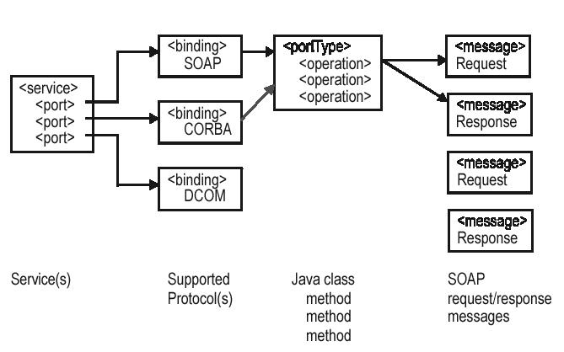
WSDL – Structure
portType
Abstract definition of a service (set of operations)
Multiple bindings per portType:
How to access it
SOAP, JMS, direct call
Ports
Where to access it

Slide 15
UDDI – Universal Description Discovery & Integration
UDDI is XML based registry to list and locate Web Services
Registry
Find
Publish (Register)
Service
Consumer
Service
Provider
Bind and Invoke (Interact)

Slide 16
Controller
Model
REST Implementation Overview
Human Web
Programmable Web
View
View
View
Portal
CCX App
Partner
Cisco Device
Scripted Interface
One unique addressable interface. Standard set of methods (GET, PUT, POST, DEL, HEAD)
Web Service
System of Record DB

Slide 17
REST – REpresentational State Transfer
REST is an architectural style and not a toolkit.
REST has
Resources are identified by uniform resource identifiers (URIs)
Resources are manipulated through their representations
Messages are self-descriptive and stateless
Multiple representations are accepted or sent
Representations
Resources are first-class objects
Resources are retrieved not as character strings or BLOBs but as complete representations
Restful

Slide 18
Resource Abstraction - Fundamentals
3 Core Tasks
Addressability: Identify and Scope a Resource by creating a URI
The resource must be a specific representation of a physical/logical data object and must map to a requisite business function
For example, http://support.cisco.com/mdf/6500/6501/6502/IOS/release/latest maps to the latest software release for specific product and software type. It is not the same as http://support.cisco.com/mdf/6500/6501/6502/IOS/release/12.2.2 even though 12.2.2 may be the latest at a specific point. The second URI represents a data object always identified by 12.2.2 while the first URL represents a data object that always points to the latest release.
The URI must be used to strictly identify and scope a resource
Methods, functions and actions must be avoided in the URI. These will be defined as the HTTP method described below
For example, http://support.cisco.com/cns/subscribe/customer=johndoe;action=update is not good practice
Methods: Identify and outline the methods that will be supported on this URI
The supported methods are GET, POST, PUT & DELETE and they map to the standard CRUD paradigm
The other supported method will be HEAD which will be used to fetch attributes or metadata for a specific object and not the object itself
All URIs will not support all five methods. For example, since we have no way of creating or updating a MDF category, the PSA will strictly support GET & HEAD
Content Negotiation: Identify the types of content this URI can provide in its response. This is the response MIME-type requested by a client and could be any accepted MIME type (Default support will be provided for HTML, XML,JSON & , possibly, PDF)

Slide 19
Resource Abstraction – Dataset & Data Elements
There are only two types of resources
Datasets: These are containers that hold collections of data elements or other Datasets. For example, the MDF category Switches, is a container that contains various data elements of type Switches.
Data Elements: These are the actual elements contained inside Datasets and of interest as a resource. For example the data elements under Switches may include ATM Switches, Blade Switches, LAN Switches etc.
Each dataset is a simple collection and must not provide complex inter-relationships and mappings
Resources can be exposed by a standard URI interface expressed as follows
http://<Cisco domain name>/{resource 1}/{resource 2}/..
For example, http://support.cisco.com/mdf/switches/ATMswitches
Distinguishing between a dataset resource and a data element resource. Since the URI itself is a standard format, some extra information needs to be in the response to identify if a URI returns a dataset or a specific element. This can be done in 2 ways
The response can contain an element type id returning either dataset or element
A GET response to a dataset will return its underlying elements while a GET response to an element will return the same URI in the response.
Example
http://support.cisco.com/mdf/switches/ will return the following in the XML response
http://support.cisco.com/mdf/switches/ATMswitches
http://support.cisco.com/mdf/switches/LANswitches
http://support.cisco.com/mdf/switches/ATMswitches will return
http://support.cisco.com/mdsf/switches/catalyst8500
http://support.cisco.com/mdf/switches/lightstreamswitches
Finally http://support,cisco.com/mdf/switches/ATMswitches/catalyst8500/ will return an element without the URL: catalyst 8510

Slide 20
REST – Standard Methods
The set of Methods include
GET (read or fetch resource content)
HEAD (read or fetch resource metadata or attributes)
PUT ( create a resource)
POST (update a resource)
DELETE (delete a resource)
Not all methods will be exposed for all resources
The framework will not allow a PUT, POST or DELETE method on a dataset. In other words datasets cannot be created through a support framework
Data elements resources may implement a PUT, POST or DELETE, but only for very specific and pre-defined functions. For e.g. a new MDF model element cannot be created, but a CNS user element can.
Data elements exposed through PUT, POST or DELETE must not be identified as part of the URI. The URI must stop at the parent dataset and the POST, PUT or DELETE request will include the actual element id, named elementID

Slide 21
SOAP v/s REST
Fundamental Difference
A traditional RPC style SOA service adds extra envelopes for every transaction. (e.g. SOAP envelope over HTTP )
Is this justified in a strictly read-only system?
Adaptability
How to account for functions that are never planned for?
REST, by abstracting the resource, lets you create more representations that can be uniquely addressed
SOAP is a bit more complex since the model has to be modified to create new methods
Scalability
REST inherently more scalable than RPC-SOA since it
strictly implements HTTP methods & Uses HTTP content-negotiation
Maintainability
In REST, most of the complexity is built into resource definition and methods are standard HTTP methods. Code base is thus much smaller
Appropriate Use – Rule of Thumb
SOAP
Requirement to control inherent data objects by exposing specific methods
Specific transaction contracts are in place (TXN awareness, reliable messaging, non-repudiation etc.)
REST
Inherent data objects used as-is. Little or no transformation requirements
TXN requirement, not to be confused with UI requirements
Resource usage is diffuse, uncontrolled and needs to be inherently adaptable

Slide 22

Workshop - SDF3.0

Slide 23
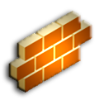

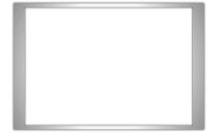
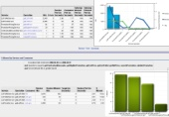


SOA Reference Architecture
CONSUMER
CONSUMER
SOA OPERATIONS DASHBOARD
INTERNAL NETWORK
CORPORATE FIREWALL
EXTERNAL GATEWAY
INTERNAL GATEWAY
EXTERNAL SERVICES REGISTRY
HTTP 2-way SSL
INTERNAL SERVICES REGISTRY
CONSUMER
COMPOSITE SERVICES
ATOMIC SERVICES
BPEL
BUSINESS RULES ENGINE
BAM
SERVICES DEV. FRAMEWORK
QUERY ACCELERATION FRAMEWORK
BPA
BUSINESS SERVICES
BUSINESS PROCESSES
BUSINESS SERVICES

Slide 24
Services Development Framework (SDF)
Services Development Framework is an Architecture that helps and simplifies development efforts in creating and consuming enterprise-ready java business services. At the same time it provides capabilities like management, monitoring, reusable components which otherwise would have to be implemented along with every application.
Service Framework is based totally on Standards like J2EE, XML, Web services, Best practices and principles like proven design patterns, Open source tools etc

Slide 25
Creating a SOAP and REST Service using SDF 3.0
Define Information Model using XML Schema.
Generate Binding Objects.
Define Service Interface.
Implement Service.
Register Service.

Slide 26
Demo: SOAP Service
Schema : EmployeeInfoModel1.xsd
Binding Objects
JAXB Binding
xjc.bat -d {outDir} -p {package} -xmlschema {schemaLoc}.
Example : xjc.bat -d C:\Projects\FY11\GCEIT\Employee\src -p com.cisco.rest.employee.test.info.model -xmlschema C:\Projects\FY11\GCEIT\Employee\src\schema\EmployeeInfoModel1.xsd

Slide 27
Demo - SOAP Service
Define Service Interface
public interface ISOAPEmployeeService extends Service {
public JAXBElement<EmployeeInfoRequestResponseType> getEmployees(JAXBElement<EmployeeInfoRequestType> reqType) throws Exception;
}

Slide 28
Demo - SOAP Service
Implement Service business logic
public class SOAPEmployeeServiceImpl extends AbstractService implements ISOAPEmployeeService {
public JAXBElement<EmployeeInfoRequestResponseType> getEmployees(JAXBElement<EmployeeInfoRequestType> empReqType) throws Exception
{
EmployeeInfoRequestType objType = empReqType.getValue();
String reqType = objType.getEmpRequest().getReqType();
String reqId = objType.getEmpRequest().getId();
…
… .
.
.

Slide 29
Demo - SOAP Service
Register Service
<ServiceRegistry
xmlns="http://www.cisco.com/serviceframework/serviceregistry"
xmlns:xsi="http://www.w3.org/2001/XMLSchema-instance"
xsi:schemaLocation="http://www.cisco.com/serviceframework/serviceregistry/serviceregistry.xsd">
<!-- Start of the Service Definition -->
<ServiceMeta serviceName="RestService" type="pojo" domainName="BusinessService">
<ClassName>com.cisco.test.RESTEmployeeServiceImpl</ClassName>
<SchemaLocation>schema/EmployeeInfoModel1.xsd</SchemaLocation>
<Transport>http</Transport>
<Parameter name="doclitBare" value="true"></Parameter>
</ServiceMeta>

Slide 30
Demo – SOAP Service
Deploy And Generate WSDL
Generate WAR / EAR file and deploy in server environment
Generate the WSDL
Example : http://svastrad-wxp01.cisco.com:8080/Employee/services/SoapService?wsdl

Slide 31
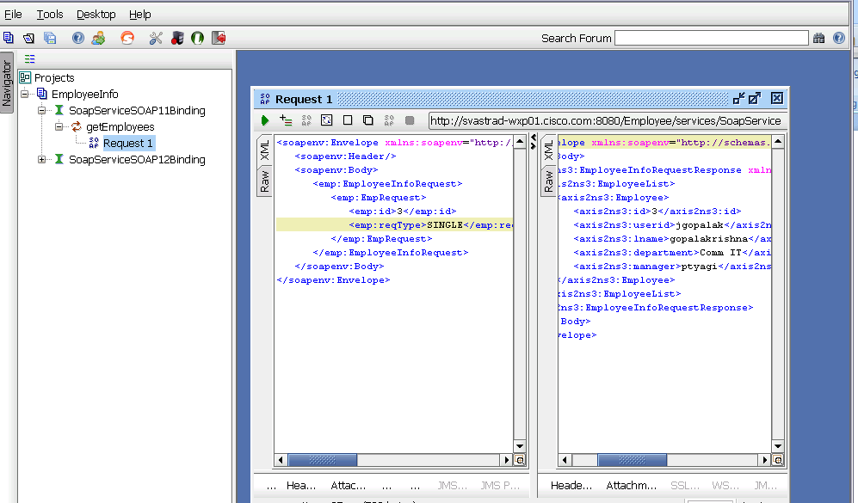
Demo – SOAP Service
Test the SOAP service
SOAP UI

Slide 32
Demo – REST Service
Define Service Interface
public interface IRESTEmployeeService extends Service {
public JAXBElement<EmployeeInfoRequestResponseType> getEmployees(PathParameter params,QueryParameter query);
}

Slide 33
Demo – REST Service
Implement Service Business Logic
public class RESTEmployeeServiceImpl extends AbstractService implements
IRESTEmployeeService {
public JAXBElement<EmployeeInfoRequestResponseType> getEmployees(PathParameter params, QueryParameter query) {
// TODO Auto-generated method stub
System.out.println("parameters count: "+params.getCount());
String queryParam = null;
queryParam = query.value("id");

Slide 34
Demo - REST Service
Register Service
<ServiceRegistry
xmlns="http://www.cisco.com/serviceframework/serviceregistry"
xmlns:xsi="http://www.w3.org/2001/XMLSchema-instance"
xsi:schemaLocation="http://www.cisco.com/serviceframework/serviceregistry/serviceregistry.xsd">
<!-- Start of the Service Definition -->
<ServiceMeta serviceName="RestService" type="pojo" domainName="BusinessService">
<ClassName>com.cisco.test.RESTEmployeeServiceImpl</ClassName>
<SchemaLocation>schema/EmployeeInfoModel1.xsd</SchemaLocation>
<Transport>http</Transport>
<Parameter name="doclitBare" value="true"></Parameter>
</ServiceMeta>
<ServiceMeta serviceName="SoapService" type="pojo" domainName="BusinessService">
<ClassName>com.cisco.test.SOAPEmployeeServiceImpl</ClassName>
<SchemaLocation>schema/EmployeeInfoModel1.xsd</SchemaLocation>
<Parameter name="doclitBare" value="true"></Parameter>
</ServiceMeta>
<!-- End of the Service Definition -->
</ServiceRegistry>

Slide 35
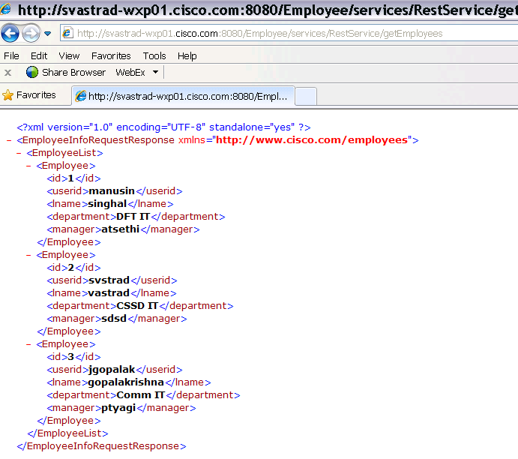
Demo – REST Service
Deploy And Test REST Service
REST Client
http://localhost:8080/Employee/services/RestService/getEmployees
http://localhost:8080/Employee/services/RestService/getEmployees?id = 3

